Slide 1
Measuring, Monitoring & Evaluating Your Service for Irish In Britain
Facilitator: Diane West www.diwest.co.uk

Slide 2
Introduction
This seminar aims to improve your ability monitor and measure your services. We will cover:
Methods of measurement and some of the jargon involved
Defining outcomes for our work
Developing an action plan for improving the monitoring and evaluation in your group

Slide 3
How to Express Aims…..
Aims describe:
What difference the group wishes to achieve for its users/clients/customers.
The aims of your group never change.
To enable...
To improve...
To increase...
To reduce...
To empower...
The following words are often used to identify aims:

Slide 4
How to Express Objectives
Objectives describe:
How the group will go about doing or achieving the change.
What actions will the organisation take.
To provide...
To support...
To offer...
To run...
To set up...
The following words are often used to explain objectives:

Slide 5
Objectives
Definition – Describe the planned activities which help you achieve your aims. Objectives may change from time to time with current trends.
This sentence states how the group will do it….
To run a drop-in centre with a play area.
To provide workshops, information and advice on parenting skills.
To organise outings for children and their parents.

Slide 6
Climate of fundraising
In order to survive we need to be able to market our services to funders appropriately. It is also important for us to know what to be able to offer each funder according to their stage of development.
Funding of organisation
Funding a worker
Funding a project
Funding particular parts of services
Funding individual service users.
Funding Changes for the community

Slide 7
Jargon Busting Pitstop!
Beneficiary
Direct or Primary
Indirect or Secondary
Milestones
Qualitative Indicator or ‘soft’ – feeling
Quantitative Indicator or ‘hard’ - number
Evidence of need - proof!
Input /Output /Outcome/ Impact

Slide 8

Beneficiary outcomes
Changes for the individual person using the service.
Changes for the family around them.
Changes for the wider. community/society at large.

Slide 9
Summary……of outcomes
Subjective measure of change
Can include:
Feelings
Emotions – self confidence / self esteem
Attitude
Behaviour
Skills development or accreditation/award

Slide 10

What are your outcomes?

Slide 11
Monitoring & Evaluation
To know whether you are achieving your aims and objectives, we need to have systems in place to measure over a period of time and compare to the targets that we set in the beginning.
This is the monitoring part.
It relies on you collecting information in the beginning: BASELINE DATA. Then comparing this later and making some assessment of the what the information is telling us. This will be the evaluation.

Slide 12
Baseline Data
Age
Gender
Postcode
Educational attainment
Qualification
Emotion – e.g. anger
Behaviour
Social skills/communication skills
Attendance
What kind of indicators are these?
Which are best suited to your service and group?

Slide 13
A word about data protection
If you are working with, and collecting information about people you would need to know more about data protection and how it impacts the way you run your service….
More information from the ICO – Information Commissioners Office
www.ico.org.uk

Slide 14
Methods of Measuring Services
Forms /registers
Questionnaires or Survey
Interviews informal or formal
Self assessment or outcome stars
Observation
Footfall
Case study
Diary / log

Slide 15
How do you decide which method ?
Do you know what you want to find out?
Do you have access to the people you need to talk/consult with?
How detailed do you need to go?
How many people do you need to talk to or what is a good sample number?
What money/people/time do you have to make this happen and what skills do they need?

Slide 16
Forms and Registers
Pros | Cons
Numbers of people | No detail
Evidence of different people | Can get lost
Cheap | People don’t do it
Attendance over a period

Slide 17
Questionnaires
Pros | Cons
Good range of information | Survey fatigue
More in depth | Take time
Better quality of info potential | More Expensive
Standardized | Barriers for completion

Slide 18
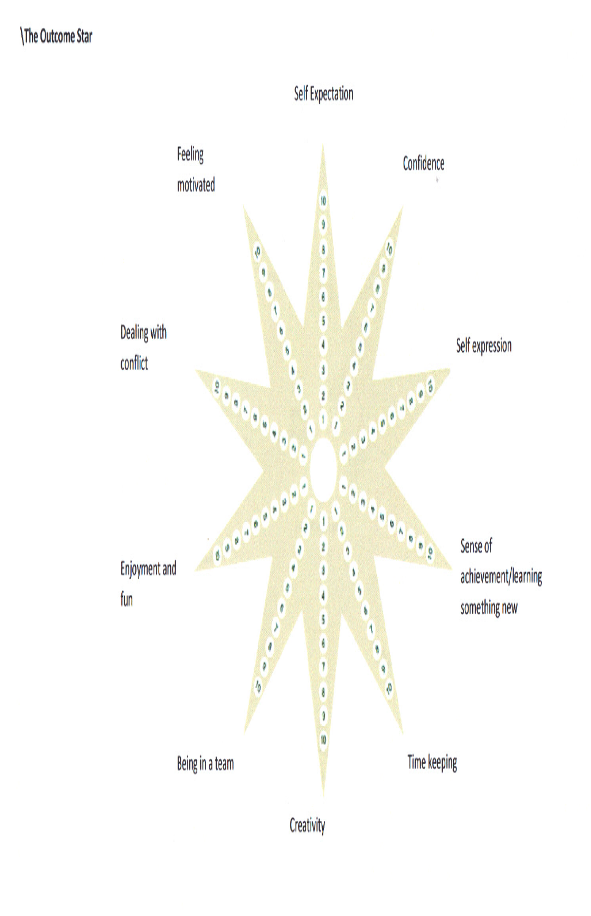
Outcome Star
Notes:
Outcome star
General – but now developed into a range of service areas:
Homelessness
Alcohol
Teens
Older People
Well Being
Worklessness
Mental Health
Family
Community
Examples on the tables for you to look at the kind of detail
18

Slide 19
The Outcome Star
Tool best used after the 1st or 2nd engagement with the service/project
Client considers how they feel being involved in the service/project in relation to each of the indicated outcomes
10 is the most positive feeling; 1 the least positive
May want to probe with client any concerns/worries
Encourage them to speak about positive feelings
Will provide a ‘profile’
Good tool to express ‘distance travelled’
www.outcomesstar.org.uk
Notes:
EXPLAIN THE PROCESS
1ST TIME – SETS THE INITIAL BASELINE
2ND TIME – RECORDS CHANGE AS A RESULT OF THE WORK DONE BY THE PROJECT
MAY NATURALLY LEAD TO A SEMI STRUCTURED INTERVIEW TO TRY AND GET THE CLIENT TO ARTICULATE ABOUT WHAT ELEMENTS OF THE SERVICE/ACTIVITY WERE EFFECTIVE OR NOT IN CONTRIBUTING TO THE CHANGE
19

Slide 20
Evaluation
In other words…..making sense of all the information you collect!!!
Regular – quarterly, biannual or annually
Who's involved? Who needs to be?
What happens to the findings? Action!
Circulation: Internal / External
Promotion……and Evidence of need for the next fundraising application!

Slide 21
Next Steps
Revisit what you are using at the moment.
Is there a need for change?
Discuss how well it is working and any ways you can improve your existing methods of monitoring or evaluating your services.
Devise a SMART plan to move things forward.

Slide 22
Example plan for the year
Area | Now | In 12 months | Steps | Resources | Indicators
Recruit 10 people | Have 1 person | 10 people recruited and trained | Develop pack Advertise… | Cost of advert | New people in place

