Slide 1
Measuring, Monitoring & Evaluating Your Service Series part 2
CASESTUDIES
Irish In Britain
Facilitator: Diane West www.diwest.co.uk

Slide 2
Introduction
This seminar aims to improve your ability monitor and measure your services. We will cover:
Measuring the softer/qualitative indicators and outcomes.
Pros and Cons of different methods.
Developing an action plan for improving the monitoring and evaluation in your group.

Slide 3
How to express aims…..
Aims describe:
What difference the group wishes to achieve for its users/clients/customers.
The aims of your group never change.
To enable...
To improve...
To increase...
To reduce...
To empower...
The following words are often used to identify aims:

Slide 4
How to express objectives
Definition – Describe the planned activities which help you achieve your aims. Objectives may change from time to time with current trends.
This sentence states how the group will do it….
To run a drop-in centre with a play area.
To provide workshops, information and advice on parenting skills.
To organise outings for children and their parents.

Slide 5
Climate of fundraising
To survive we need to be able to market our services to funders appropriately.
Funders use their guidance to explain their themes and priorities.
Funding of organisation
Funding a worker
Funding a project
Funding particular parts of services
Funding individual service users.
Funding Changes for the community

Slide 6
Jargon Busting Pitstop!
Beneficiary
Direct or Primary
Indirect or Secondary
Milestones
Qualitative Indicator or ‘soft’ – feeling
Quantitative Indicator or ‘hard’ - number
Evidence of need - proof!
Input /Output /Outcome/ Impact

Slide 7
Monitoring & Evaluation
To know whether you are achieving your aims and objectives, we need to have systems in place to measure over a period and compare to the targets that we set in the beginning.
This is the monitoring part.
It relies on you collecting information in the beginning: BASELINE DATA. Then comparing this later and making some assessment of the what the information is telling us. This will be the evaluation.

Slide 8
What is Baseline Data
Age
Gender
Postcode
Educational attainment
Qualification
Emotion – e.g. anger
Behaviour
Social skills/communication skills
Attendance
What kind of indicators are these?
Which are best suited to your service and group?

Slide 9
How do you decide which method ?
Do you know what you want to find out?
Do you have access to the people you need to talk/consult with?
How detailed do you need to go?
How many people do you need to talk to or what is a good sample number?
What money/people/time do you have to make this happen and what skills do they need?

Slide 10
Methods of Measuring Services
Forms /registers
Questionnaires or Survey
Interviews informal or formal
Self assessment or outcome stars
Observation
Footfall
Case study
Diary / log

Slide 11

Beneficiary outcomes
Changes for the individual person using the service.
Changes for the family around them.
Changes for the wider. community/society at large.

Slide 12
Summary……of outcomes
Subjective measure of change
Can include:
Feelings
Emotions – self confidence / self esteem
Attitude
Behaviour
Skills development or accreditation/award

Slide 13

What are your outcomes?

Slide 14
River of Life
Tool which enables clients to tell the ‘story’ of their involvement with the service/activity
Both bad and good from the start to the present day
At the end of the process client goes through the story
Said to be holistic as client controls the process – blank sheet of paper without any preconceived ideas or expectations
Notes:
SEE NOTES ON EXAMPLE
14

Slide 15
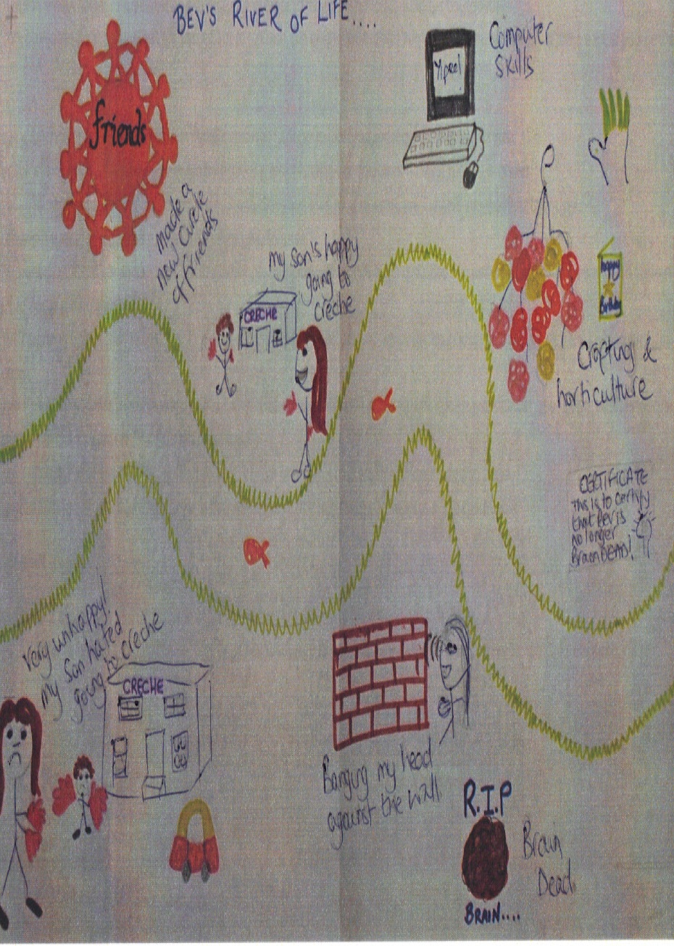
Notes:
15

Slide 16

Diary or Log

Slide 17
Diary or Log
Pros | Cons
High quality information | Small numbers of people
Self directed /User led | Relies on individual and their cooperation
Cheap | People don’t do it or loose interest it has a large impact for the project
In depth | Consistency can present challenges

Slide 18
Questionnaires
Pros | Cons
Good range of information | Survey fatigue
More in depth | Take time
Better quality of info potential | More Expensive
Standardized | Barriers for completion

Slide 19
The Outcome Star
Tool best used after the 1st or 2nd engagement with the service/project
Client considers how they feel being involved in the service/project in relation to each of the indicated outcomes
10 is the most positive feeling; 1 the least positive
May want to probe with client any concerns/worries
Encourage them to speak about positive feelings
Will provide a ‘profile’
Good tool to express ‘distance travelled’
www.outcomesstar.org.uk
Notes:
EXPLAIN THE PROCESS
1ST TIME – SETS THE INITIAL BASELINE
2ND TIME – RECORDS CHANGE AS A RESULT OF THE WORK DONE BY THE PROJECT
MAY NATURALLY LEAD TO A SEMI STRUCTURED INTERVIEW TO TRY AND GET THE CLIENT TO ARTICULATE ABOUT WHAT ELEMENTS OF THE SERVICE/ACTIVITY WERE EFFECTIVE OR NOT IN CONTRIBUTING TO THE CHANGE
19

Slide 20
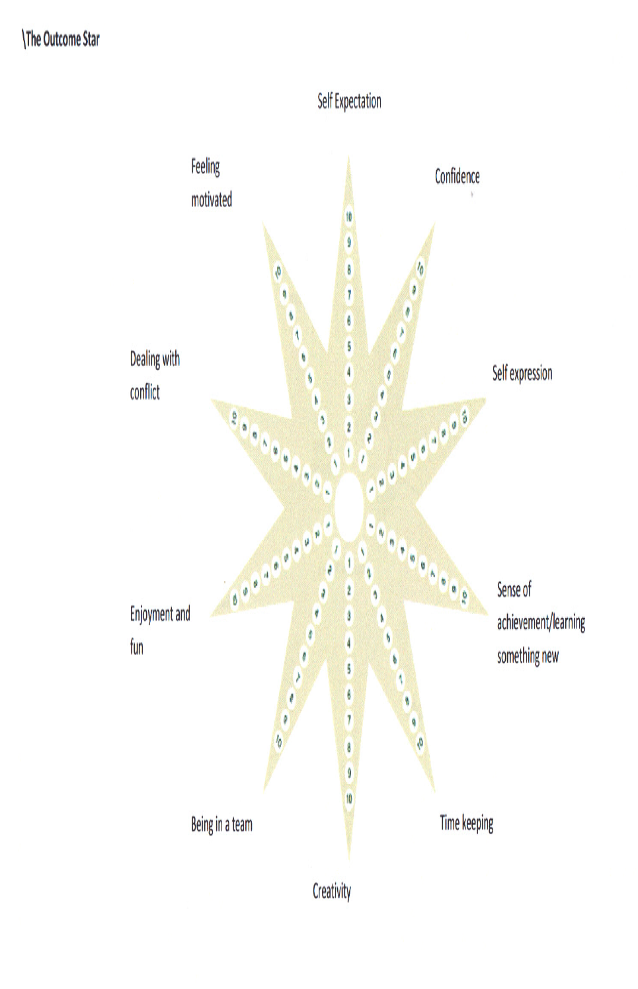
Outcome Star
Notes:
Outcome star
General – but now developed into a range of service areas:
Homelessness
Alcohol
Teens
Older People
Well Being
Worklessness
Mental Health
Family
Community
Examples on the tables for you to look at the kind of detail
20

Slide 21
A4 case studies or story
Asking people set number of questions at one point in time and then asking the same, a period later.
Flexible resource.
Can be designed around your service.
Can involve a range of people; tutors, practitioners, volunteers, families.
Using templates can improve consistency
Let's look at an example…..

Slide 22
Case Studies on Individuals
Starting point
Progress
Outcome
Physical
Improvement
Active life
Emotional
Increased confidence
Happier

Slide 23
Evaluation
In other words,…..making sense of all the information you collect!!!
Regular – quarterly, biannual or annually
Who's involved? Who needs to be?
What happens to the findings? Action!
Circulation: Internal / External
Promotion……and Evidence of need for the next fundraising application!

Slide 24
A word about data protection
If you are working with, and collecting information about people you would need to know more about data protection and how it impacts the way you run your service….
More information from the ICO – Information Commissioners Office
www.ico.org.uk

Slide 25
Next Steps
Revisit what you are using at the moment.
Is there a need for change?
Discuss how well it is working and any ways you can improve your existing methods of monitoring or evaluating your services.
Devise a SMART plan to move things forward.

Slide 26
Example plan for the year
Area | Now | In 12 months | Steps | Resources | Indicators
Recruit 10 people | Have 1 person | 10 people recruited and trained | Develop pack Advertise… | Cost of advert | New people in place

