Slide 1

The Independent Office for Police Conduct
Derrick Campbell
Regional Director - Midlands
June 2022
Notes:
You may want to use this point to introduce yourself, your background and how you came to work in this field.

Slide 2

> Who we are
The IOPC, formerly the IPCC came into existence in January 2018 led by a Director General.
IPCC existed from 2004 with significant expansion from 2013.
Securing and maintaining public confidence in the police complaints system in England and Wales. We investigate the most serious complaints and incidents, as well as handling certain appeals from people who are not satisfied with the way police have dealt with their complaint.
We are independent, and make our decisions entirely independently of the police and government.
Jurisdiction over:
43 geographic police forces
Police and Crime Commissioners and their deputies
London Mayor’s Office for Policing and Crime, and his deputy
Certain specialist police forces (including the British Transport Police and the Ministry of Defence Police)
Her Majesty’s Revenue and Customs (HMRC)
National Crime Agency (NCA)
Staff who carry out certain border and immigration functions who now work within the UK Border Force and the Home Office
Officers carrying out certain functions at the Gangmasters and Labour Abuse Authority (GLAA)
Notes:
Since 2013 the IPCC has doubled in size taking on six times as many investigations. The then Home Secretary Theresa May initiated the expansion so that we can investigate all serious and sensitive cases involving the police.
We asked the Government for structural changes to better suit our much expanded organisation. The result - dual line of accountability through commissioners and the executive team removed and replaced with a Director General.
Since we no longer have a Commission structure, our name is no-longer appropriate, hence why we were renamed the Independent Office for Police Conduct to reflect our new and strengthened structure.

Slide 3
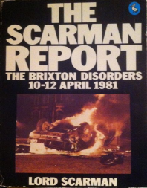


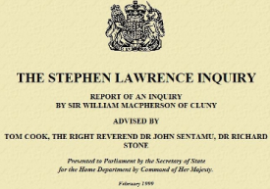
> History of the IOPC
2000 – Liberty publish study on independent investigation of police called the IPCC
1981 –
Brixton Riots and publication of Lord Scarman Report
April 1993 –
The death of
Stephen Lawrence
April 2004 – IPCC operational and replaces the PCA
1977 –
Police
Complaints Board
2002 – Police
Reform Act 2002
Jan 2018 – IPCC transitions to IOPC
1999 – Publication of Macpherson Report
1985 -
Police Complaints Authority operational
Notes:
Maintaining public confidence in policing by independent scrutiny is fundamental to why our organisation and its predecessors exists.
The first police oversight in the UK was not put into place until almost 150 years after Sir Robert Peel created the Metropolitan Police with the creation of the Police Complaints Board (PCB) in 1977. This was a response to serious concerns about police corruption and a perceived lack of independence in the police complaints process. The PCB was subject to much criticism due to its lack of powers, authority and consequent inability to instil confidence in the public.
Police Complaints Authority
The Scarman report was commissioned by the UK Government following the 1981 Brixton riots. The riots involved confrontation between the Metropolitan Police and protestors in Lambeth, South London when the mistrust and underlying tensions between the police and the black community culminated in violence. The hostility between the police and the black population partially stemmed from young black men being disproportionately targeted by stop and search powers known as the "Sus law." This referred to powers under the Vagrancy Act 1824, which allowed police to search and arrest members of the public when it was believed that they were acting suspiciously, and not necessarily committing a crime.
Lord Scarman found there was a loss of confidence and mistrust in the police and their methods of policing and recommended concerted efforts to recruit more ethnic minorities into the police force. Lord Scarman’s recommendations rested on a need for the police to carry out their duty with the consent and support of the community. He recommended changes in training and law enforcement and said that the procedure for handling complaints against the police needed to be substantially reformed if it is to command public confidence.
In 1985 the PCB was replaced by the Police Complaints Authority. However the PCA could do little more than its predecessor. In addition to the limited powers it inherited, it could only supervise a police investigation, the reports of which could not be disclosed.
IPCC
The inquiry into the death of Stephen Lawrence by Sir William Macpherson in 1999 called for the establishment of an independent body to oversee the police. In April 2000 Liberty issued a study called ‘An Independent Police Complaints Commission’ which proposed the creation of an organisation, independent of the police, to investigate complaints against police officers. Partly in response to this, in May 2000 the government carried out a consultation on a new police complaints system. This culminated in the Police Reform Act 2002 which established the IPCC. The IPCC became operational in April 2004.
IOPC
In February 2013, the Home Secretary announced that she was going to increase resources given to the IPCC to enable it to take on all ‘serious and sensitive’ matters. This led to our increase in size and change of structure. The government is making significant changes to the police complaints system and the IOPC will have new powers, designed to make us more effective and decisive in addressing public concerns. I’ll talk about these in a bit more detail later on.

Slide 4

> Public confidence in policing
Notes:
Public confidence in policing - what does that mean? (You may want to ask them this)
Independent scrutiny and decision-making – i.e. We are independent, and make decisions independently of the police, government and interest groups.
Openness and transparency
Accessibility - to ensure that the system is accountable and responsive.
Fairness
Learning and improving police practice – demonstrating change and preventing future incidents arising
The IOPC has a statutory duty to secure and maintain public confidence in the police complaints system in England and Wales.
Maintaining public confidence in policing is vital because we are policed by consent in exchange for the powers that are given to the police. Without the consent of the public, the powers of the police become ineffective. That is why our role to independently scrutinise is important.

Slide 5

> How we’re set up
Director General – Michael Lockwood
Six non-executive directors
Deputy Director General, Operations
Five Regional Directors
Director for Wales
Director, Strategy and Impact
Director, Resources
Director, People
General Counsel
Notes:
We are led by a Director General, Michael Lockwood.
Michael leads the executive team and he chairs the Board of the IOPC, which includes six non-executive directors. Michael is also the head of an operational team led by the Deputy Director General and including regional directors and a Director for Wales, who are responsible for the IOPC’s operational work in their regions.
By law, our Director General can never have worked for the police. Also none of our executive team, regional directors or our Director for Wales have worked for the police.

Slide 6
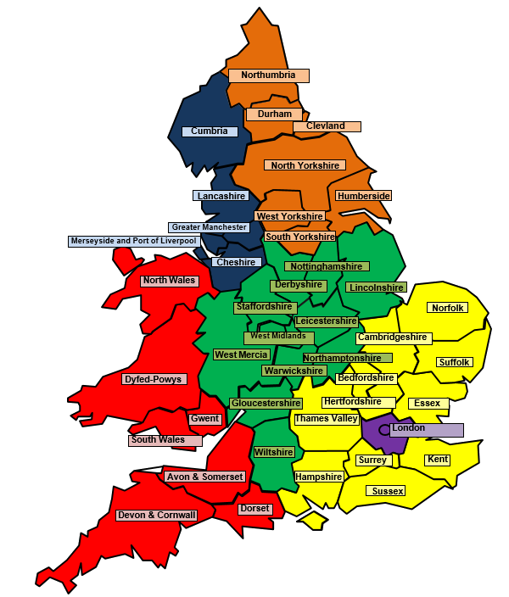
> Role of Regional Directors and Director for Wales
Director General
Michael Lockwood
Deputy Director General
Ian Todd
Regional Director
North West
Amanda Rowe
Regional Director
North East
Miranda Biddle
Regional Director
Midlands
Derrick Campbell
Regional Director
London
Jonathan Green
Director for Wales
Catrin Evans
Regional Director South East
Sarah Green
Notes:
The regional operational structure has decision-making powers delegated from the Director General through to Regional Directors and a Director for Wales.
We are the public face of the organisation, which involves working with the police and other stakeholders, and dealing with the press and media.
The purpose of our role is to lead investigations of police complaints, conduct matters and serious incidents to high standards, building public confidence in the police complaints system and ensuring that learning is identified and used to improve policing practice.
We develop and maintain external relationships, actively engaging with local communities, partner bodies and police forces in the regions.

Slide 7
> Matters we consider
Complaint
An expression of dissatisfaction by a member of the public about the conduct of a person serving with the police.
Conduct matter
Any matter where there is an indication that the police may have behaved in a manner which would justify criminal or disciplinary proceedings.
Death or serious injury matter
Any circumstances in, or as a result of which, a person has died or sustained serious injury and was either in police custody or had recently come into contact with the police and an indication that the contact may have caused or contributed to the death or injury.
Notes:
At the heart of a complaint is someone who is unhappy with the service they received or the way they have been treated by their police force.
Dissatisfaction offer forces a great opportunity to learn from, and address any common concerns that their local communities express. Done properly, this can be really positive for police and community relations.

Slide 8
> Mandatory referrals
All death or serious injury (DSI) matters
All complaints and recordable conduct matters that include allegations of conduct which constitutes:
A serious assault
Serious sexual offence
Serious corruption
Criminal offence or behaviour, which is aggravated by discriminatory behaviour
A relevant offence (carries potential sentence of seven years or more)
Notes:
Most complaints about the police are dealt with by the relevant police force. Each force has a separate department that oversees complaints. These are called ‘Professional Standards Departments’ (PSDs).
But, the police must refer certain types of matter to us. Referral to the IOPC is an important part of ensuring public confidence in the accountability and integrity of the police complaints system.
Nb. The serious corruption definition has recently been updated to make clear that abuse of authority for sexual gain is a type of serious corruption.

Slide 9
> What happens following a referral to the IOPC?
Refer to the IOPC?
Yes
Has the IOPC
determined it must be investigated?
For the Appropriate Authority to handle
as they see fit
No
Yes
Investigation
Independent
Manage
Supervise
Return for local investigation
Notes:
When a matter has been referred to us, we decide whether the matter should be investigated and the mode of the investigation, having regard to the seriousness of the case and the public interest.
We may choose to conduct our own independent investigation, manage or supervise a police investigation, or decide that the matter can be dealt with locally by the police.
We will independently investigate the most serious and sensitive complaints and incidents, considering factors like whether there is a potential breach of Article 2 ECHR, vulnerability, public concern, any thematic issues / concerns, criminality, the seniority of the officer…

Slide 10


> Outcomes
Learning vs blame culture
Accountability
Notes:
The way that the police complaints system is set out in legislation often leads us down the route of looking at individual conduct when there are often broader issues. Some of the challenges for us in the way that the complaints and conduct system are currently designed include:
A low threshold for indication of conduct and criminal offence and a low threshold for referral by us to CPS
A low threshold for case to answer for misconduct or gross misconduct
A failure to make effective use of performance management and the fact it does not apply at all to senior ranks
We need to ensure that our work does not just focus on looking for someone to blame but on the bigger picture – were there any systemic failings or broader issues that can be addressed to stop the same thing happening again? What can we learn from this complaint? What is the cause of dissatisfaction? More often than not complainants, their families, the wider community simply want to be listened to and ensure the incident does not happen again. Given the nature of the police role where there will be complaints, it is important to take all complaints, including the less serious matters seriously and with a focus of improvement. Such empathy helps to build greater trust.
This shift to learn from incidents/ matters of concern is a shift we are already seeing in the police service, and there are a number of good practice examples – such as, debriefing sessions and serious case reviews.
A blame culture means that people fear sharing what they know, but when this happens we cannot learn from it. For example, how will we know that someone performed their best but was operating with incomplete knowledge when something adverse happened?
We want a culture where mistakes and harm are prevented by openness, reflection, listening and learning. We want a culture that encourages the sharing of information without fear of reprisal. It is important to break down barriers that inhibit learning, and this requires strong leadership. The aviation and healthcare sector are good examples where this happens.
This does not take away from the importance of accountability. It is important to differentiate genuine misconduct from errors made by well-intentioned people or from failures in the system.
New legislative change under the Policing and Crime Act 2017 will bring about key changes to the police complaints and discipline systems to strengthen public confidence in policing and simplify the system. These changes have been reflected in our Statutory Guidance that has been published on our website for public consultation. I would encourage you to have a read. Some of the changes include for example:
PCCs having a greater role in oversight of the local complaints system and replacing chief constables as the review/ appeal body for ‘lower level’ complaints. The IOPC will deal with reviews of the more serious cases.
A new category ‘practice requiring improvement will be introduced to deal with lower-level matters of misconduct or performance, and the threshold for misconduct will be raised. This is intended to refocus the system so that lower level matters are dealt with in a more proportionate and constructive manner.
There will be a super-complaints system through which systemic concerns can be raised by ‘designated bodies’, HMICRFS will administer the system.
The IOPC will have a greater emphasis on learning and has statutory powers to make learning recommendations to police forces and others. Where we make a formal recommendation, we must publish the recommendation, the recipient of the recommendation must respond within 56 days and their response must be published. This helps ensure that our formal recommendations are given proper consideration and not just filed away for later.
Three times a year we publish a learning the lessons magazine. This uses anonymised case studies to highlight and illustrate learning. It asks questions of both policy makers and front line officers to help them consider ‘could it happen here?’ They also signpost relevant guidance and information. Our latest issue on stop and search has taken a different approach by widening it’s scope to include the views of both policing and non-policing stakeholders to embrace diversity of thought, raise awareness of concerns and inform how we approach solutions. If anyone is interested in these, they are available on our website where you can also sign up for the mailing list.

Slide 11
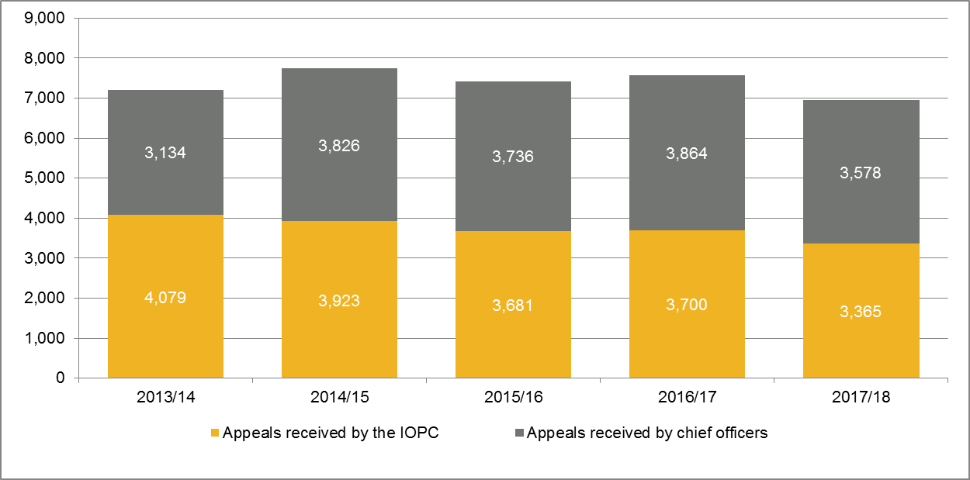
> Appeals
A complainant has the right to appeal about the way in which a police force has handled their complaint.
The responsibility for determining appeals is shared between the IOPC and the chief officer.
In 2017/18, the total number of appeals across the entire police complaints system fell by 8% (7,564 to 6,943).
We upheld 37% of valid appeals made after a police investigation into a complaint
Changes to appeals – reasonable and proportionate handling
Appeals received 2013/14 - 2017/18
Notes:
In addition to carrying out investigations, the IOPC considers certain appeals from people who are unhappy with the way the police have dealt with their complaint. An appeal offers a final opportunity to consider whether the complaint could have been handled better at a local level and, where appropriate, to put things right. If a complainant is still dissatisfied after an appeal he or she may seek to challenge the appropriate authority’s decision through judicial review.
The IOPC deals with all appeals relating to:
A person’s complaint not having been recorded
Complaints about senior officers
Potential breaches of Article 2 or 3
Complaints which have been referred to the IOPC
If none of these criteria apply, the appeal will be considered by an independent person within the police force.
Currently there are different types of appeal that relate to a different process for dealing with a complaint which can be quite a bureaucratic process. Next year this will be simplified and look simply at whether the handling of the complaint was ‘reasonable and proportionate’.
You could if you wanted have a discussion around what reasonable and proportionate means in the context of complaints handling. I.e. when you achieve a fair balance of the relevant considerations and provide a clear, evidence-based rationale for any decisions taken. Key points reflected in our Statutory Guidance (that is out for public consultation) include the following:
Reasonable’ refers to doing what is appropriate given all the circumstances of a matter. It includes undertaking proportionate actions required to bring a matter to a suitable conclusion, taking into account the facts of the matter and the context in which it has been raised.
‘Proportionate’ refers to ensuring that there is a corresponding relationship between the seriousness of a matter and the response to it. It means that the response should have due regard to the nature of the incident, and any actual or potential impact or harm to individual(s), communities or the wider public. Consideration should also be given to the potential impact on confidence in the police and the police complaints system.
Principles of reasonable and proportionate handling are:
customer service focus
case by case approach
considering the wider context
fair and effective decisions

Slide 12
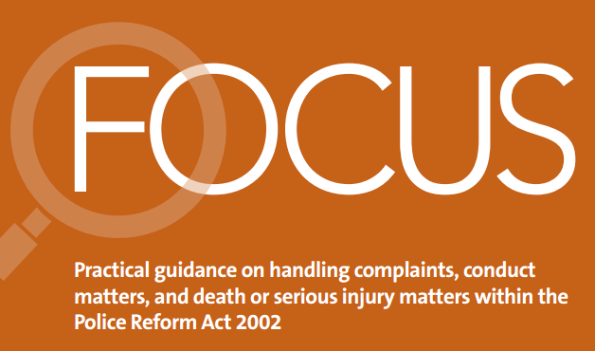
> Oversight
Support and hold police forces accountable in their use of the complaints system
Force liaison leads
Regular ‘Focus’ bulletins
Thematic work
Notes:
In order to improve the complaints system and public confidence in it, we need to not only deal with cases ourselves through our investigation and appeal work, but support forces to use the complaints system appropriately and hold them accountable for how they do this.
We work with PSDs and OPCCs as well as other oversight bodies (HMICFRS, College of Policing) and publish each year, figures on complaints recorded by each police force in England and Wales that are dealt with under the Police Reform Act 2002. The report also presents figures on the number of appeals and decisions on them. The report is a useful tool that the police and public can use to judge objectively how well complaints are being handled.
In our oversight team we have force liaison leads. They are responsible for maintaining relationships with the professional standards departments of police forces outside individual cases. They can offer advice and guidance and act as a regular point of contact to follow up on any thematic issues and understand what’s going on within individual forces. They work alongside Regional Directors to do this.
The Oversight team also publish regular bulletins called Focus. These focus on specific topics around complaints handling for example recording complaints or making referrals. They explain the legislation and promote best practice using case studies.
The team also carries out thematic studies for example a review of how police forces deal with complaints alleging discrimination and a review of access to the complaints system.

Slide 13

> Stakeholder Engagement
Essential to:
achieve our statutory duty to secure and maintain public confidence in the police complaints system,
improve the confidence of those groups that have the least confidence - young people and people from BME communities.
Engagement tools include:
Service user feedback
Public perceptions tracker
Youth panel
Mental health research
External Stakeholder Reference Group Panel and Wales Stakeholder Forum
Network of Advocates
Notes:
Effective engagement is essential to building trust and confidence in the services we deliver; as an organisation we are committed to developing stronger relationships with our stakeholders at national, regional and local levels to improve our understanding of their needs, and involve them in the shape and design of both our services and the wider complaints system.
In recognition of the fact that we need to work with stakeholders to better understand the needs of the public and work to improve public confidence in the complaints system, we have a dedicated stakeholder engagement team to support this work, and we are gaining a richer picture of how we are viewed and better feedback on where we can make improvements.
Public perceptions tracker
We have commissioned work to understand public perception of the IOPC and the police complaints system. The report focuses on the following demographics alongside the overall England and Wales population: younger people (18-24), BMEs, the upper social grades, the lower social grades, and those with a condition or disability. Consistently it shows that young people and people from BME communities have the least confidence.
Youth Panel
This year we established a youth panel consisting of young adults aged 16-25 years to find out how we can better engage with young people to increase their confidence in the complaints system. The members come from different locations across England and Wales and vary in age, gender, ethnicity and sexual orientation.
The panel provides a platform for young people to talk openly to us about their experiences and inform the IOPC on ways we can improve their confidence in the system. They are self-governing, with the freedom to speak openly and honestly with us.
Mental health
Mental health is an underlying theme in many of the cases that we investigate, especially where a death has occurred. We have commissioned the Institute Of Mental Health in Nottingham to conduct research to explore the confidence of people with mental health concerns in the police complaints system and their likelihood and ability to engage with it. Specific topics the research is exploring include:
Contact with the police and the police complaints system, including satisfaction with police interaction
Levels of awareness and understanding of the IOPC and the wider police complaints system
Accessibility of and confidence in the police complaints system
Actual and perceived challenges around the police complaints system
Exploring any improvements that could be made
External Stakeholder Reference Group Panel and Wales Stakeholder Forum
A range of external stakeholders (policing/ statutory and non-statutory) meet quarterly to challenge and provide constructive feedback on the IOPC’s performance and key projects.
Network of Advocates
The SE team has established a national network of non-statutory advocacy organisations across low confidence, seldom-heard and thematic stakeholder groups. Many of our Network of Advocates are members organisations, ‘umbrella’ bodies and/ or operate within both a national and regional structure. Our engagement with these organisations provides a gateway to communities, helping us understand varying experiences, barriers to the police complaints system and perceptions of the IOPC.

Slide 14
Questions?

